Slide 1


An Industrial Training Presentation
‹#›
Prepared By: Guided By:
Purva Galani (20203103510349) Dr. Rachana Patel
B.Tech. (8th Semester) (CE) Assistant Professor (CE)
CGPIT. CGPIT.

Slide 2
Outline
2
Company Profile
Timeline Chart
Training Work
Project Introduction
Project Objective
Technologies/Platform
Modules of Project
Screenshot of work during training
Future work
Reference
Notes:
‹#›

Slide 3
Company Profile
‹#›
Name: Sprier Technology Consultancy
At SPRIERS, we believe in creating solutions that matter. Our team of dedicated professionals works tirelessly to bring your vision to life, ensuring every project is handled with precision, creativity, and care.
Technologies:
Next.js, Node js , Express js, MongoDb, Cloud services, UI-UX.
Address :
Shop No. G-26, GREEN PALLADIA, opp. RAJ WORLD SHOPPING CENTER, nr. RAJHANS ORANGE, Palanpur, Surat, Gujarat 395009
Services:
Cloud Computing
Web Development
App Development
Saas Development
Cloud & Devops
Notes:
‹#›

Slide 4



Timeline Chart
ACTIVITY | 23 DEC - 25 DEC | 26 DEC- 31 DEC | 1 JAN- 7JAN | 8 JAN-28 JAN | 1 FEB-7 FEB | 10 FEB-..
Requirement Analysis
Designing
Implementation
Testing
Hosting

Slide 5
Training Work(Next Js)
What is Next.js?
Next.js is a React framework for building full-stack web applications.
Next.js. for additional features and optimizations.
Whether you’re an individual developer or part of a large team, Next js can help you build interactive,dynamic and fast React applications .

Slide 6
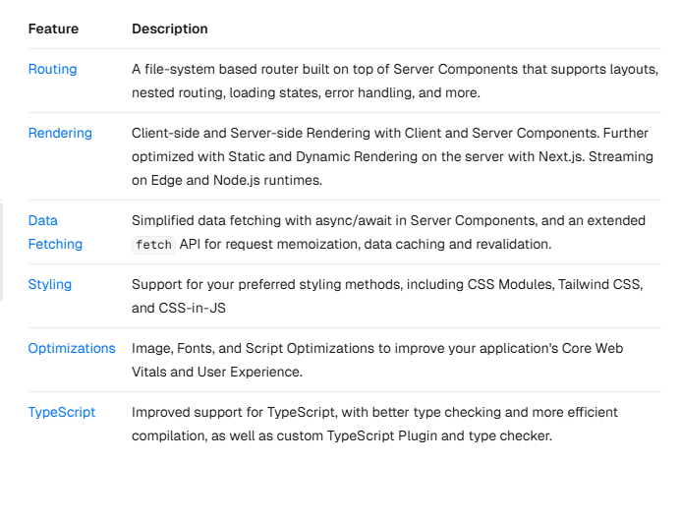
Training Work(Next Js)
Main Features :

Slide 7
Project Introduction
Our live project is a Customer Relationship Management (CRM) System built using Next.js, aimed at helping businesses manage their customer interactions, sales pipelines, and internal workflows more effectively.
The project focuses on delivering a fast, responsive, and secure web application that provides real-time data management, enhances productivity, and improves customer engagement.
As part of the development team, My primary contribution involved designing and developing the notification and reminder functionalities, ensuring seamless user experience and real-time updates.as wll as user authentication/security.

Slide 8
Project Objective
The primary objective of this CRM project is to develop a robust, scalable, and user-friendly system that helps businesses optimize their customer management processes and improve operational efficiency.
Improve customer relationships and communication.
Increase customer retention and satisfaction.
Centralize and organize customer data.
Automate tasks to boost productivity.
Streamline sales processes and track leads.
Integrate with existing business tools.

Slide 9
Technology
Frontend: Next.js, HTML/CSS , Material ui
Backend: Node Js,Express
Database: MongoDB
Authentication: Passport.js, JWT
Cloud Hosting: AWS
Version Control: Git, GitHub
Testing:Postman
Other Tools & Libraries : Socket.IO, Axios

Slide 10
Modules
Signin/signup
Dashboard
Add Lead
Add Invoice
Contact
Complaint
Google Login
charts
profile
reminder/notification
task

Slide 11
About Internship Area
‹#›
Domain | Web Development Internship
Duration of Internship | Starting Date | Ending Date
 | 23-12-2024 | 22-05-2025
Mode of Internship (Online/Offline) | Offline
Live Project (Yes/No) | Yes
Working in Team/Individual | Yes, Working in Team
Notes:
‹#›

Slide 12
Learning Outcome (Week 7 & 8)
1.Drag-and-Drop Status Management
I worked on implementing a drag-and-drop interface similar to the Kanban-style views used in popular CRMs like Zoho CRM and Odoo CRM.
Task 1: Setting up Status management
This feature allows users to visually manage the status of items such as leads, tickets, or tasks by dragging them between different status columns (e.g., "New", "In Progress", "Completed", etc.).
Each column represents a specific status, and when an item is dragged from one column to another, its status is updated in real time in the backend database.
Task 2: Setting up Drag-and-Drop
I used drag-and-drop libraries such as React DnD or react-beautiful-dnd on the frontend, while ensuring that the updated status is persisted in the backend using API calls.
This mirrors the functionality seen in Zoho CRM's deal pipeline or Odoo's task management system, where users can seamlessly move cards across stages to reflect progress.

Slide 13
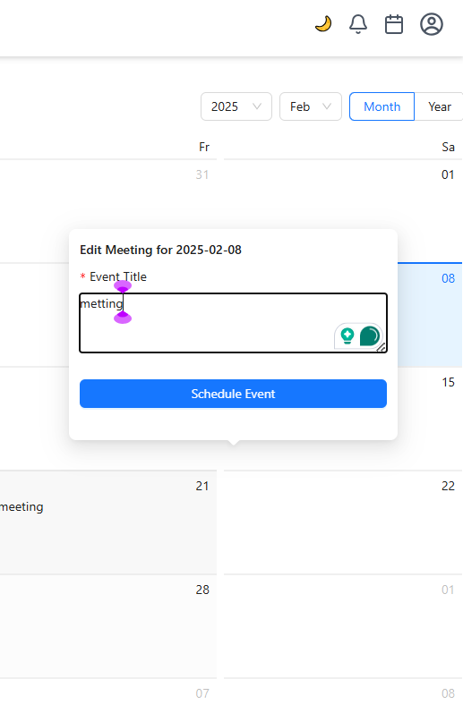
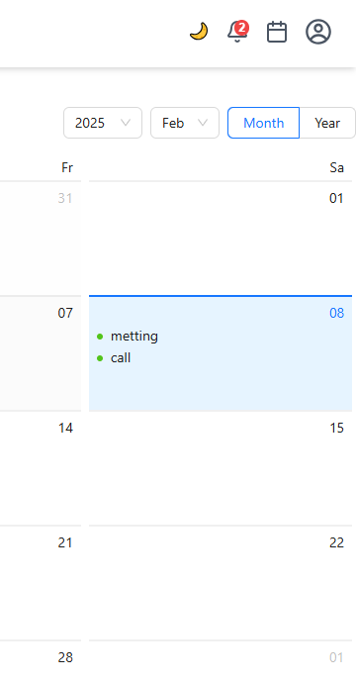
1.1 Add reminder notes in calender
1.2 reminder notes in calender and notification

Slide 14
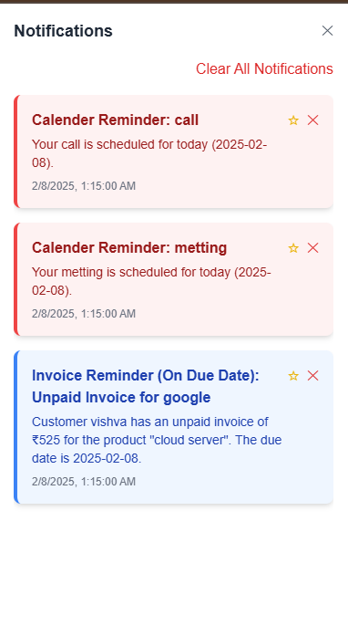
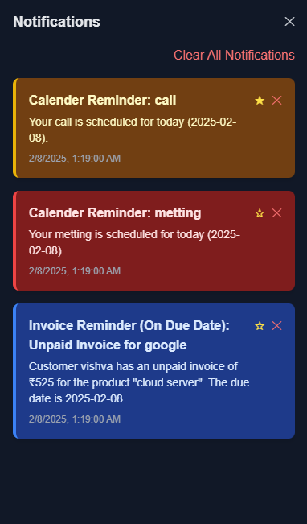
1.3 notification panel
1.4 notification panel dark mode

Slide 15
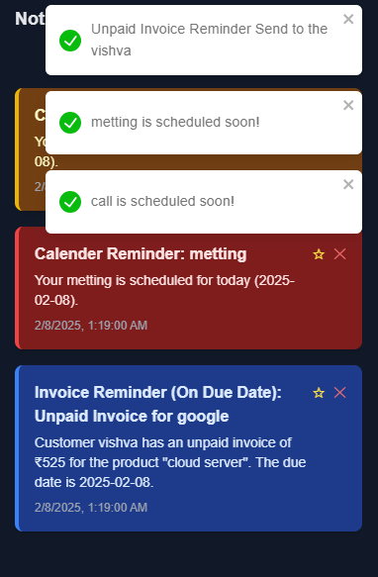


1.4 toast notification
1.5 notification count
1.4 toast notification

Slide 16
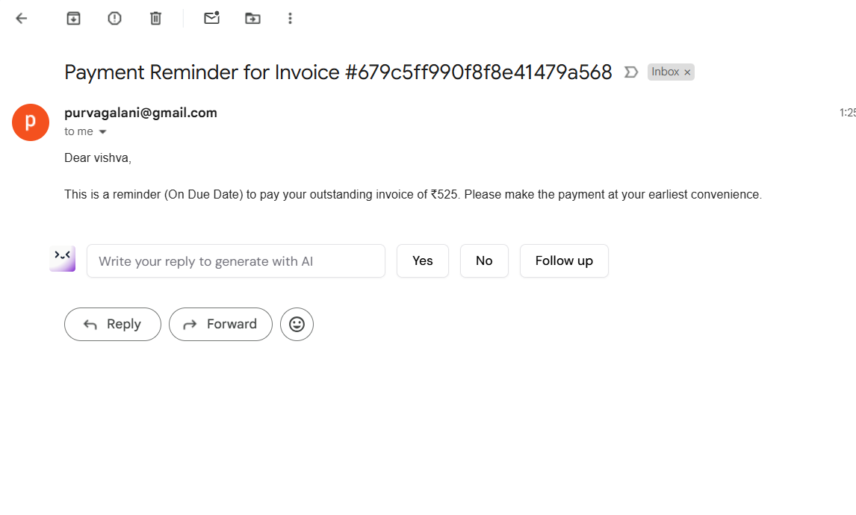
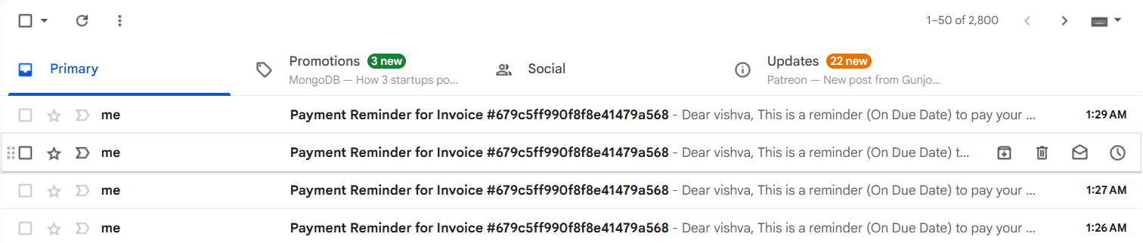
1.6 reminder to email

Slide 17
Learning Outcome (Week 9 & 10)
2. Drive Implementation
In this project, I developed a Drive module integrated within the CRM system to handle secure document storage and management, similar to the document modules available in CRMs like Zoho Drive or Odoo Documents.
This feature allows users to upload, preview, download, and delete files, ensuring all relevant documents related to leads, clients, or internal processes are easily accessible within the CRM.
The frontend provides a user-friendly interface built using React (or Next.js), where users can drag-and-drop files or select them manually for upload. The backend, developed with Node.js and Express, handles the file processing. Files are stored securely on the server (or cloud storage like AWS S3, if applicable), and references are maintained in a MongoDB collection for easy retrieval.
Additionally, the system supports filtering by file type, search functionality, and categorization, making document management efficient and organized.

Slide 18
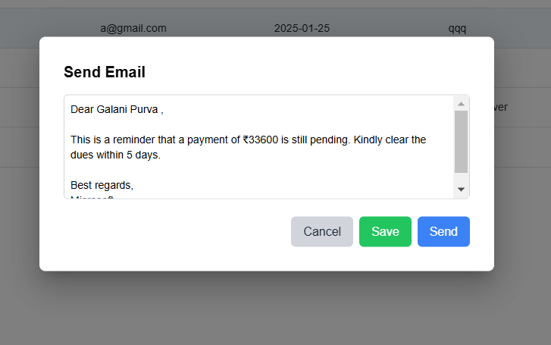
2.1 mail, whatsup, call button
2.2 send mail

Slide 19
1.4 toast notification
2.3 reminder to email and send mail

Slide 20
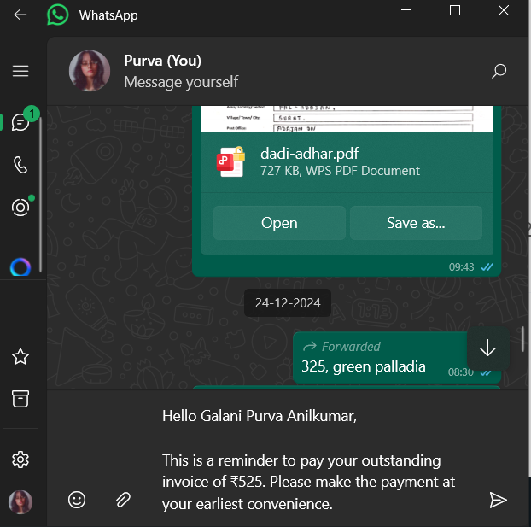
2.3 send whatsup msg

Slide 21
Learning Outcome (Week 11 & 12)
3. Graphical representation :
To provide a visual overview of business performance, I implemented graphical dashboards for Leads, Invoices, and Deals, with data categorized and displayed according to their monetary value (amount).
This feature helps users and administrators quickly analyze revenue trends, sales performance, and pipeline health within the CRM system.
The graphs are generated using modern chart libraries such as Recharts, Chart.js, or ApexCharts integrated into the React (or Next.js) frontend. Each module displays relevant charts—for example:
Leads by Estimated Value – A bar or pie chart showing the number and value of leads in various stages.
Deals by Amount – A bar or line chart that visualizes deal values across stages like "Negotiation", "Won", and "Lost".

Slide 22
Invoices by Total Billed – A stacked bar or area chart showing invoice amounts over time (monthly/quarterly).
By implementing these graphs, the CRM becomes more data-driven and insightful, similar to what is available in enterprise CRMs like Zoho Analytics or Odoo Dashboards, giving users a clear picture of business metrics at a glance.

Slide 23
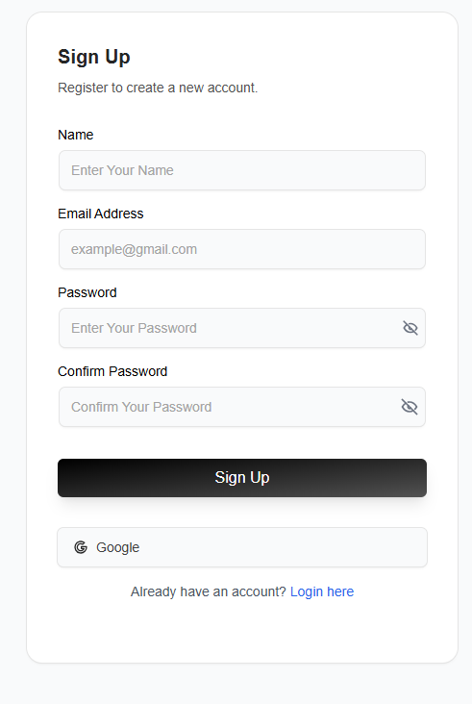
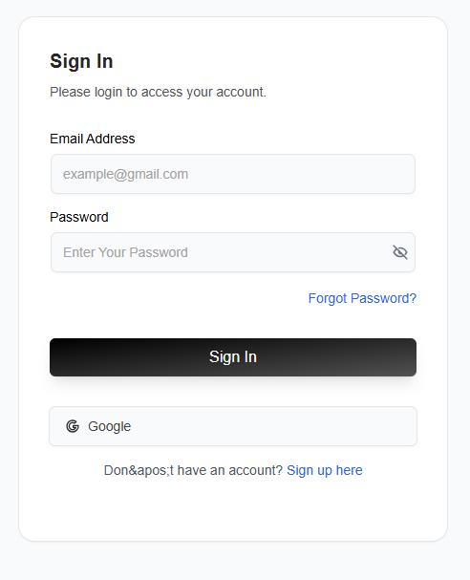
2.3 send whatsup msg
3.1 and 3.2 sign in and sign up

Slide 24
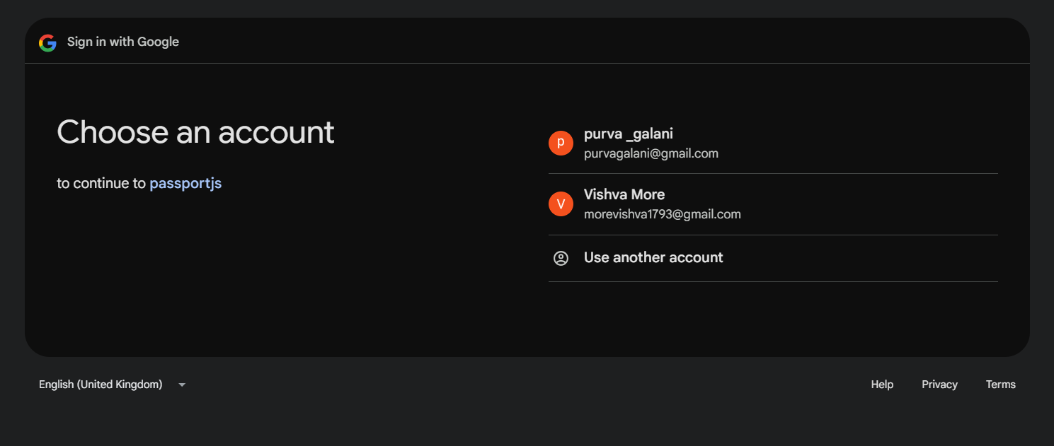
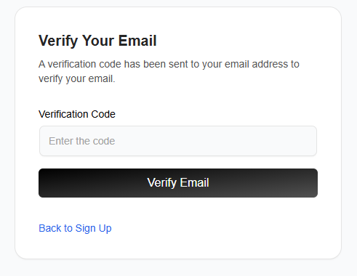
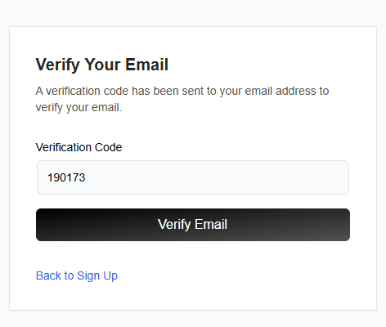
3.1 and 3.2 sign in and sign up
3.3 sign in with google
3.4 verifiy email

Slide 25
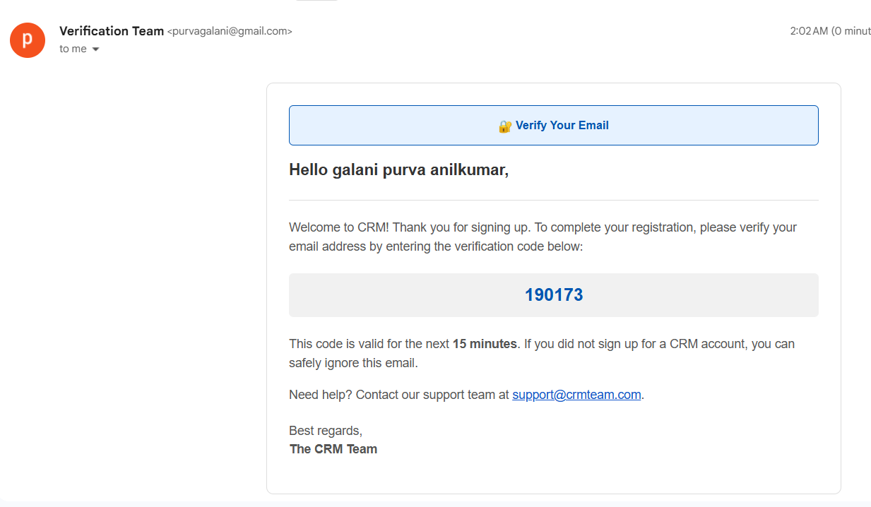
3.5 verifiy email code to email

Slide 26
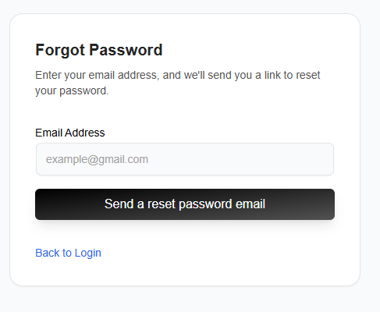
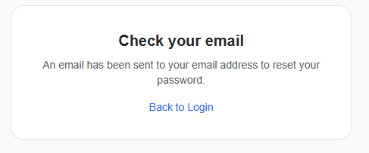
3.6 forgot password

Slide 27
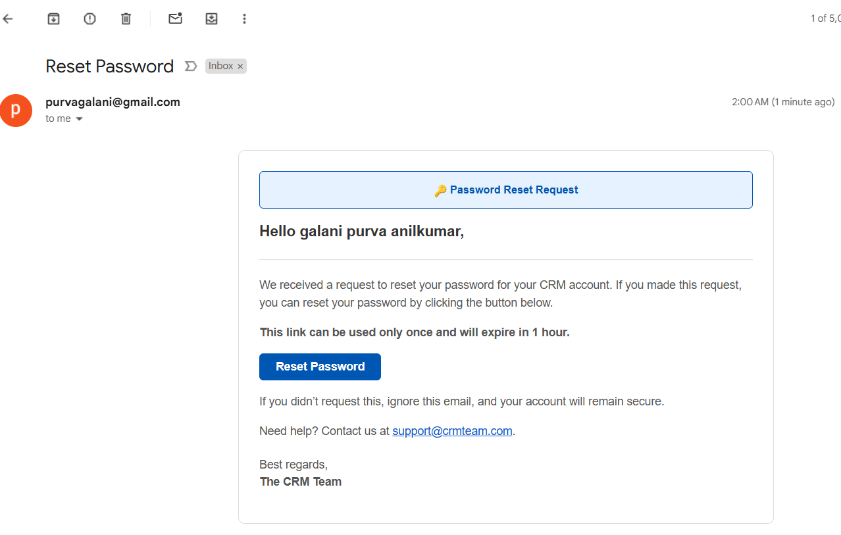
3.7 forgot password email

Slide 28
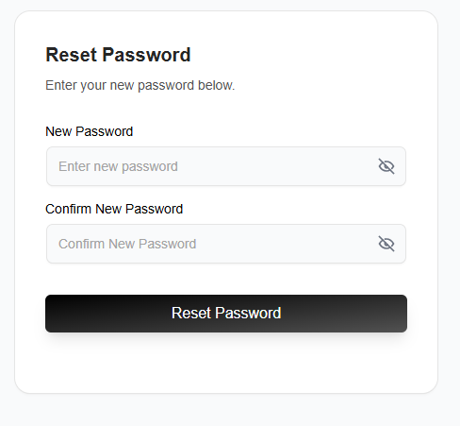
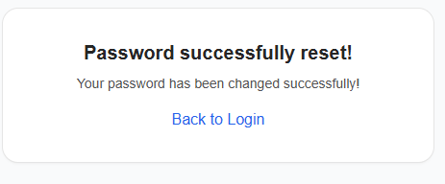
3.8 rest password

Slide 29
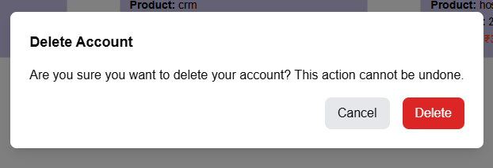
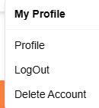
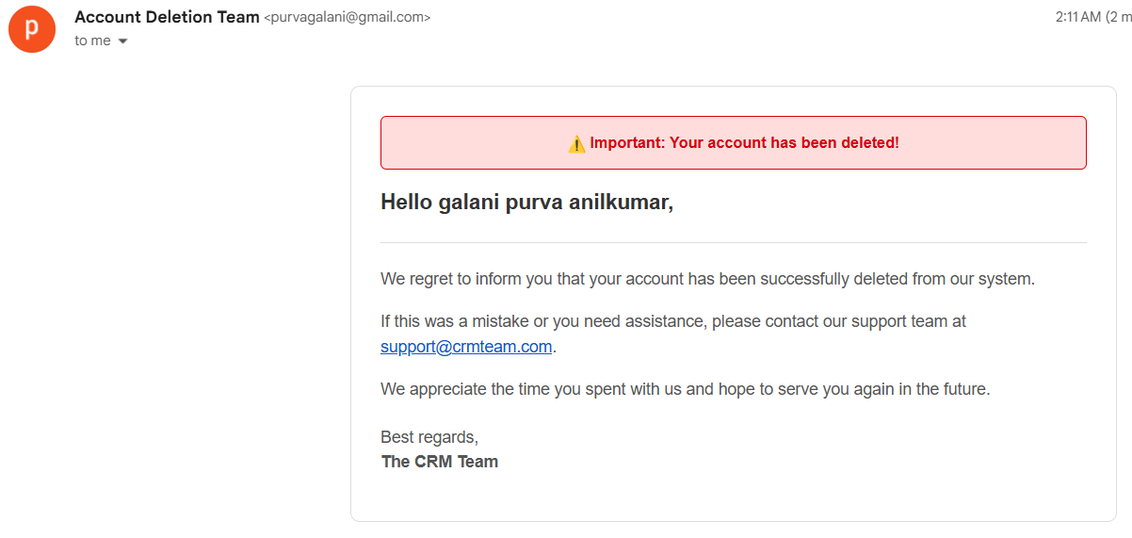
3.9 delete account and
log out

Slide 30
Learning Outcome (Week 13 & 12)
‹#›
CRM Module Page Creation and Management
To build a fully functional and user-friendly CRM system, I designed and implemented dedicated pages for each core module—Leads, Invoices, Deals, Tasks, Complaints, Contacts, and Schedules. These pages are structured to allow users to easily create, view, update, and manage all relevant records within the system.
List/Table View to display existing records with search, sorting, and pagination.
Create/Edit Form with all necessary input fields (e.g., name, status, amount, due dates, priorities, assigned user).
Detail View to inspect full record information and related activity logs.
Notes:
‹#›

Slide 31
Learning Outcome (Week 13 & 12)
‹#›
Here's a brief on how each module functions:
Lead Page: Allows tracking of potential customers with fields like name, source, estimated value, and current stage.
Invoice Page: Handles billing-related data such as invoice number, amount, status (paid/unpaid), and client details.
Deal Page: Tracks sales opportunities and negotiations with deal stages and associated values.
Task Page: Lets users assign and manage work with priorities, deadlines, and completion tracking.
Complaint Page: Manages customer issues, categorizing them by type, urgency, and resolution status.
Notes:
‹#›

Slide 32
Learning Outcome (Week 13 & 12)
‹#›
Contact Page: Stores all client and business contact information with options to tag leads, companies, or deals.
Schedule Page: Helps users plan meetings, calls, or follow-ups with calendar integration and reminders.
All pages are built using React/Next.js for the frontend, with backend APIs in Node.js/Express to handle CRUD operations. Form validations, loading indicators, and feedback messages are implemented for a smooth user experience. Access is controlled based on user roles to ensure data security and integrity.
These modules collectively ensure that the CRM is a centralized and efficient tool for managing business operations and client relationships—similar in flow and structure to professional CRMs like Zoho CRM and Odoo.
Notes:
‹#›

Slide 33
Conclusion
‹#›
In my internship i learnt that how to work with industry with new technology. how to communicate with team members .Develop my leadership and time management skill . I was working with React JS. During this span i become very punctual to my team and company members. Really, It was nice experience for me.
Notes:
‹#›

Slide 34
‹#›
Thank You

